Slide 1
Clipping
Course Code: CSC 3224
Course Title: Computer Graphics
Dept. of Computer Science
Faculty of Science and Technology
Lecturer No: | 14 | Week No: | 11 | Semester:
Lecturer: | Dipta J Gomes

Slide 2
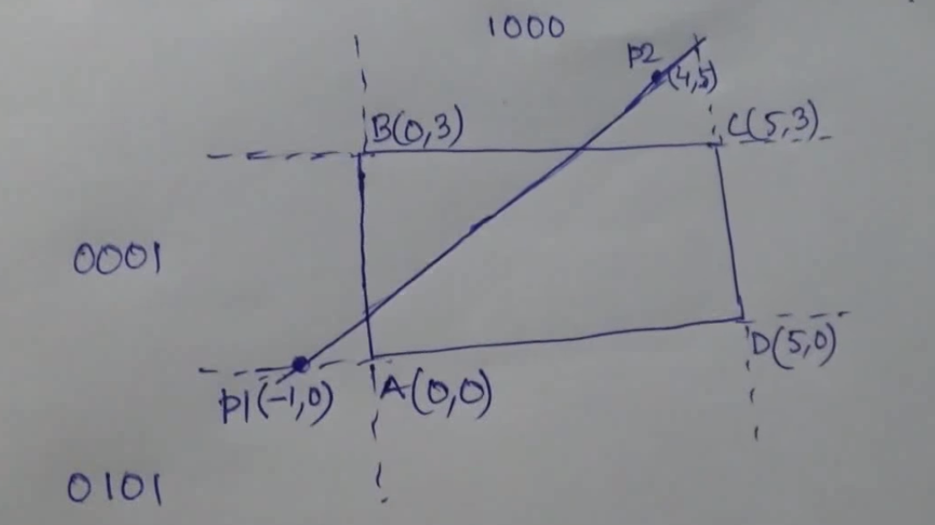
Problem Solving (Line Clipping)

Slide 3
Problem Solving (Line Clipping)

Slide 4
Problem Solving (Line Clipping)

Slide 5
Find Slope, m

Slide 6
Problem Solving (Line Clipping)

Slide 7
Find Y1ʹ

Slide 8
Problem Solving (Line Clipping)

Slide 9
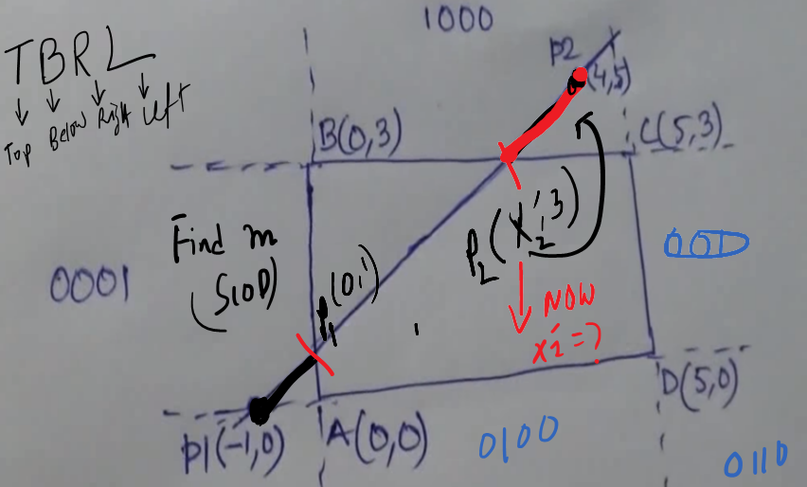
Find X2ʹ

Slide 10
Find X2ʹ

Slide 11
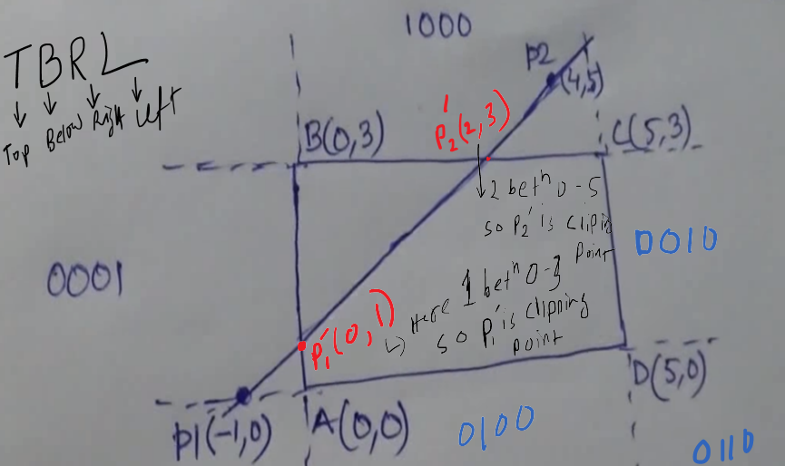
Finally

Slide 12
Books
Foley, van Dam, Feiner, Hughes, Computer Graphics: principles and practice, Addison Wesley, Second Edition.
Schaum's Outline of Theory & Problems of Computer Graphics.
Peter Shirley Steve Marschner , “Fundamental of computer graphics”, Third Edition.

Slide 13
References
Chapter 3: Foley, van Dam, Feiner, Hughes, Computer Graphics: principles and practice,
Addison Wesley, Second Edition.
https://en.wikipedia.org/wiki/Clipping_(computer_graphics)
https://www.onlinestudy.xyz/2019/06/clipping-in-computer-graphics.html

